Slide 1
One bibliographic record with multiple 773 host item entry fields
Yoel Kortick – Senior Librarian

Slide 2
  Introduction
  Our specific examples
  The catalogued record
  What happens in Primo

Slide 3


Introduction

Slide 4
Introduction
There are cases where multiple 773 Host Item Entry fields appear in one bibliographic record, each pointing to a different bibliographic record.
For example, there may be
  One article which was published in multiple journals.
  One essay published in multiple collections of essays.
  One short story published in multiple collections of short stories.
  A combination of the above.

Slide 5
Introduction
The following is a real actual example and not just “made up” for the purposes of this demo.
The short story “The scribe” by Shmuel Yosef Agnon was published in both of the following collections of short stories:
  A book that was lost and other stories
  Twenty-one stories
It was also published in the journal “The Jewish Quarterly”

Slide 6

Our specific examples

Slide 7
Our specific examples
The repository includes the following three titles, all of which contain the well-known story by Shmuel Yosef Agnon “The scribe”:
  A book that was lost and other stories. ISBN 0805241205
  Twenty-one stories. ISBN 0575005505
  “The Jewish Quarterly, vol. 23, no. 1-2 (83-84), spring-summer 1975”. ISSN 0449-010X

Slide 8
Our specific examples
In order to aid the user, some of the specific stories in the collections have been catalogued as a separate bibliographic record.
One of the specific stories is “The scribe”
The “The scribe” not only appears in subfield t of the 505 formatted contents note in the collections of stories, but also appears as its own bibliographic record.

Slide 9

The catalogued record

Slide 10
The catalogued record
The record for the title “The scribe” with multiple 773 fields does not have a holdings record (or inventory of any type).
The other three titles each have their own holdings record and item(s).

Slide 11
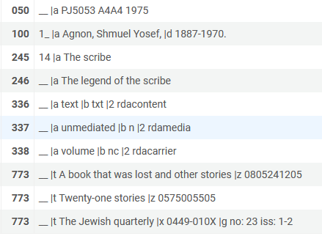
The catalogued record
Here is the record for the story “The scribe” with multiple 773 fields, each pointing to a different record

Slide 12
The catalogued record
This field points to title “A book that was lost and other stories” which is ISBN 0805241205

Slide 13
The catalogued record
This field points to title “Twenty-one stories” which is ISBN 0575005505

Slide 14
The catalogued record
This field points to title “The Jewish quarterly” which is ISSN 0449-010X
This field specifically points to enumeration a (volume) 23, enumeration b (issue) 1-2.

Slide 15

What happens in Primo

Slide 16
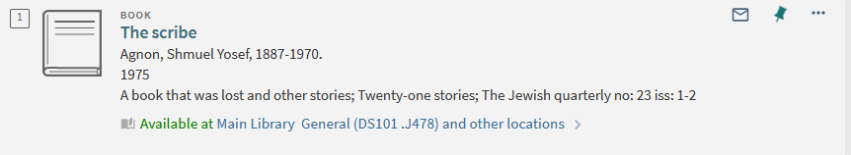
What happens in Primo
When the user searches for “The scribe” he finds the title and sees the link to the inventory of the other three related records.
The titles of the records in the 773 fields
The inventory of the records in the 773 fields

Slide 17
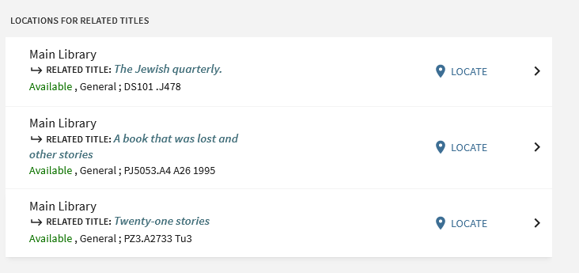
What happens in Primo
When the user clicks the Availability link he or she sees the availability of the item(s) of each related record
Let’s “drill down” and click ‘locate’ for “Twenty-one stories”

Slide 18
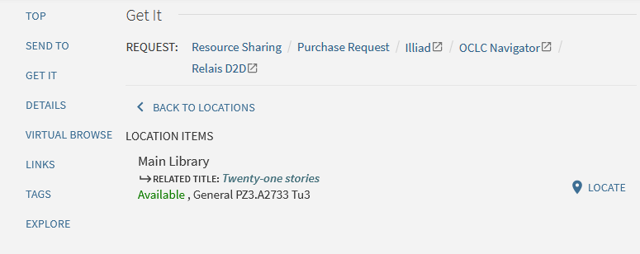
What happens in Primo
After clicking one of the specific items the user sees the item details

Slide 19
xxx@exlibrisgroup.com

